Slide 1



From Coverage Computation to Fault Localization: A Generic Framework for Domain-Specific Languages
Faezeh Khorram¹, Erwan Bousse¹, Antonio Garmendia², Jean-Marie Mottu¹, Gerson Sunyé¹, Manuel Wimmer²
¹IMT Atlantique, Nantes Université, Nantes, France
²Johannes Kepler University (JKU), Linz, Austria

Slide 2
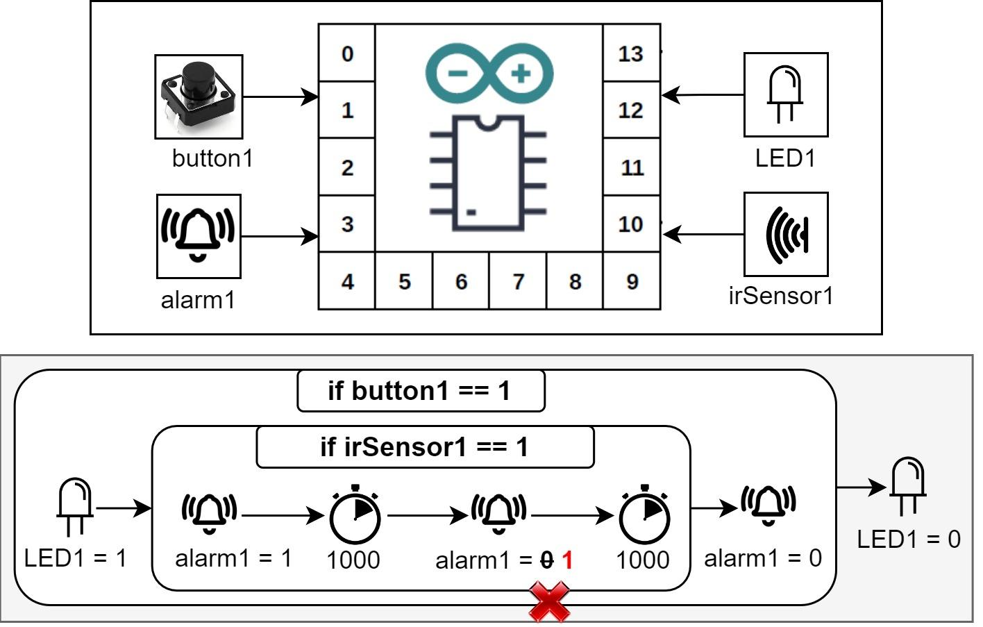
Context: Executable Domain-Specific Language (xDSL)
DSL with execution semantics
Used for defining behavioral models
Models describing dynamic aspects of a system
Running Example: xDSL for modeling Arduino boards and their behaviors (xArduino)

Slide 3
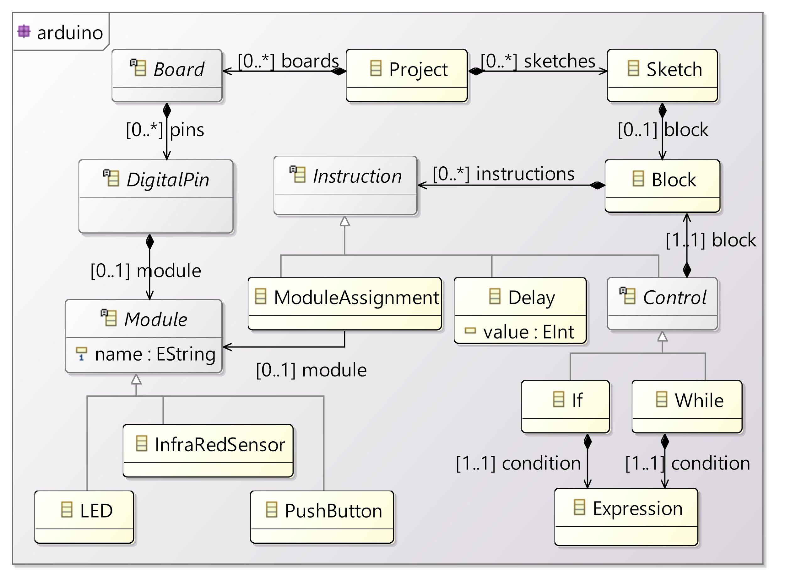
Context: Executable Domain-Specific Language (xDSL)
Abstract Syntax
Domain concepts defined in an Ecore metamodel

Slide 4
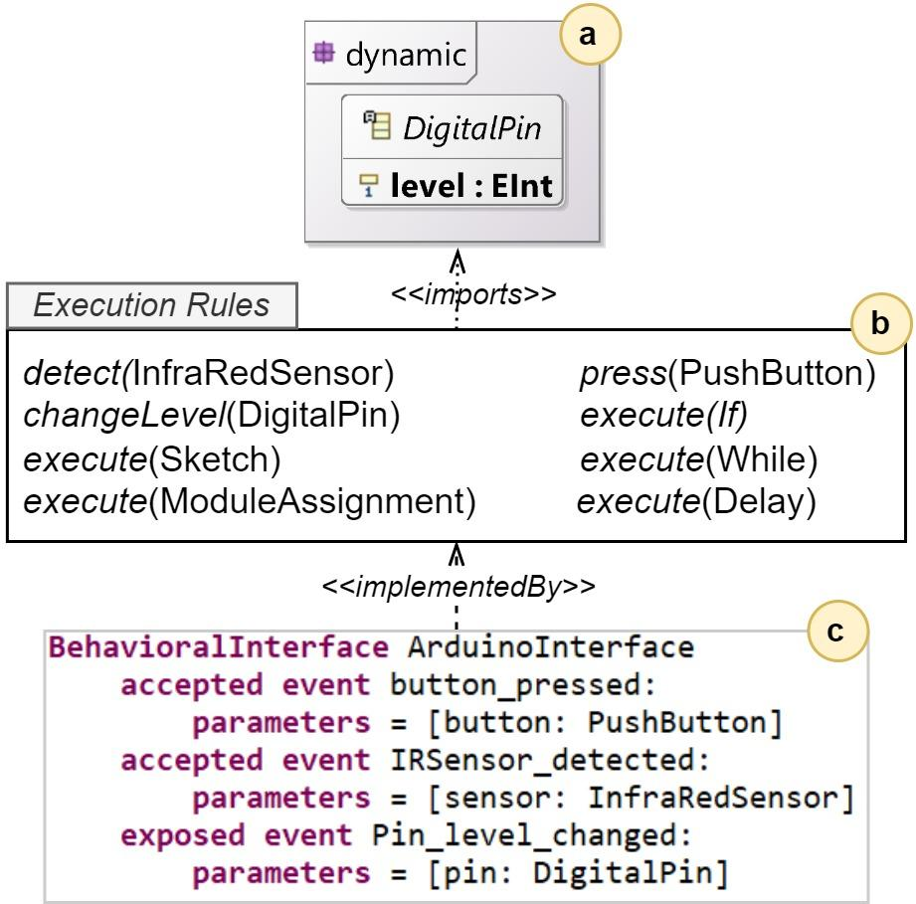
Context: Executable Domain-Specific Language (xDSL)
Operational Semantics (Interpreter)
Definition of runtime state
Execution rules: changing runtime state to execute a model
Behavioral Interface [1]
How to interact with a running model
a
b
c
[1] Leroy, D., Bousse, E., Wimmer, M., Mayerhofer, T., Combemale, B. and Schwinger, W., Behavioral interfaces for executable DSLs. Software and Systems Modeling, 19(4), pp.1015-1043, 2020.

Slide 5
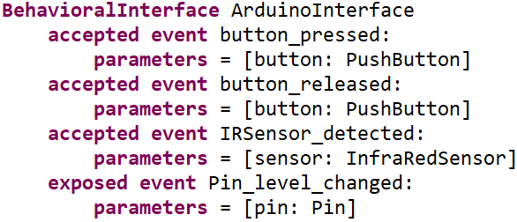
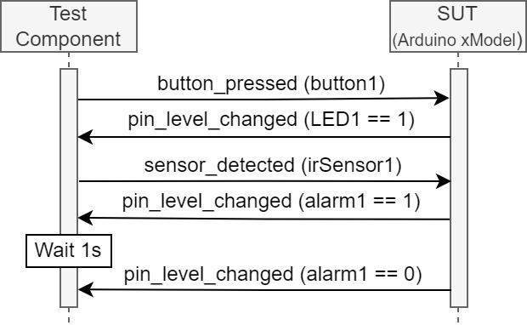
Context: An Example Test Case for the xArduino model [2]
Using events of the behavioral interface to define test data
test input data and expected output are both a trace of events
Using the operational semantics to run the test case and get the verdict
[2] Khorram, F., Bousse, E., Mottu, J.M. and Sunyé, G., Advanced testing and debugging support for reactive executable DSLs. Software and Systems Modeling, pp.1-27, 2022.

Slide 6
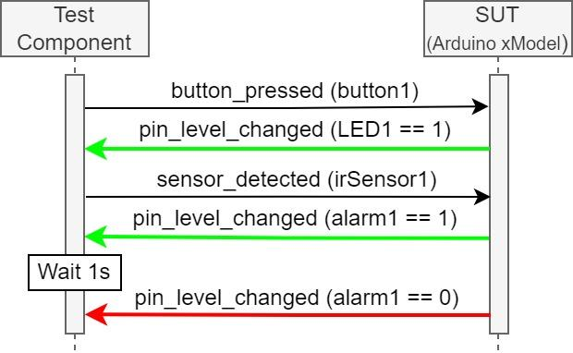
Context: An Example Test Case for the xArduino model [2]
Using events of the behavioral interface to define test data
test input data and expected output are both a trace of events
Using the operational semantics to run the test case and get the verdict
[2] Khorram, F., Bousse, E., Mottu, J.M. and Sunyé, G., Advanced testing and debugging support for reactive executable DSLs. Software and Systems Modeling, pp.1-27, 2022.

Slide 7
Problem Statement
Questions:
Is a set of test cases good enough for a given model?
How to localize the faults causing test cases to fail?
Answer: Coverage Computation
A well-known technique for test quality measurement
The foundation of an advanced fault localization technique: Spectrum-Based Fault Localization (SBFL)
Notes:
Coverage definition: The ability of a test suite in analyzing all parts of its system under test

Slide 8
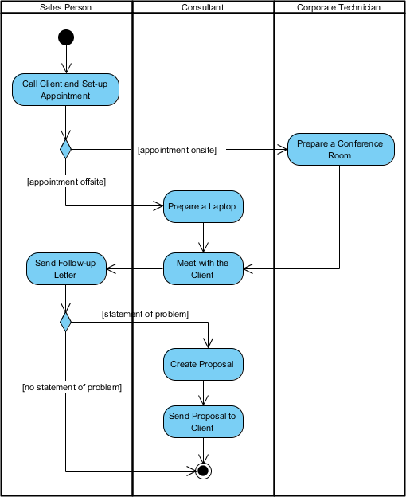
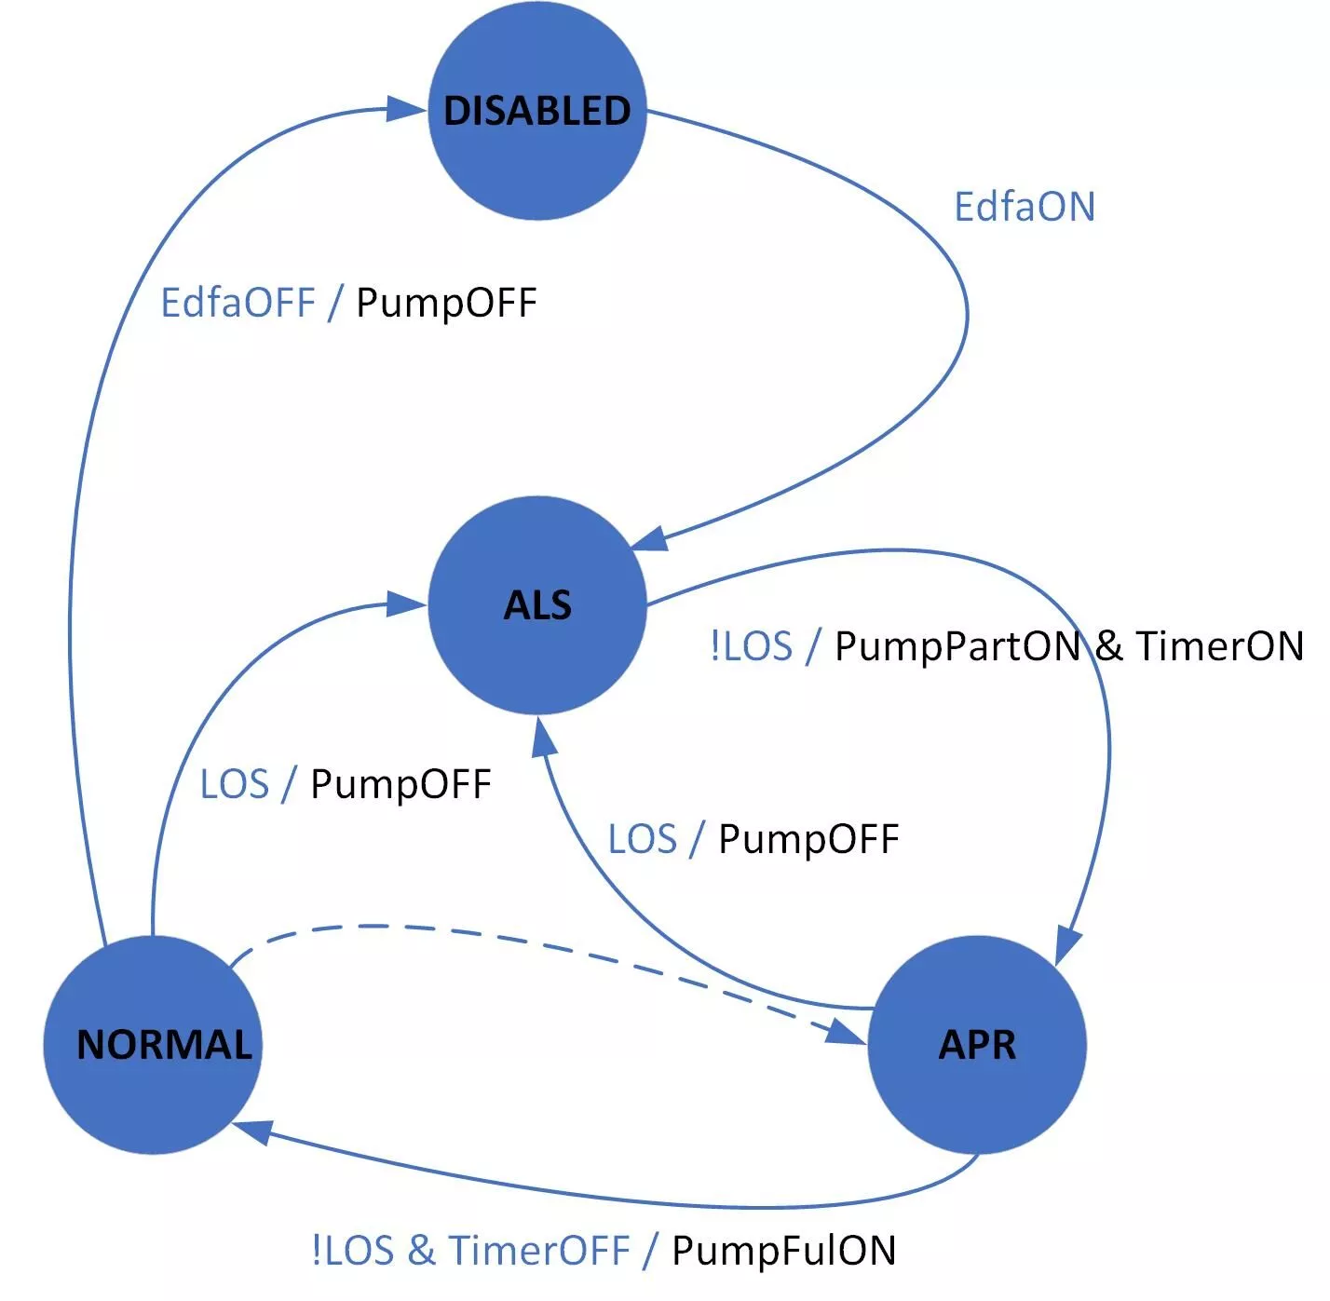
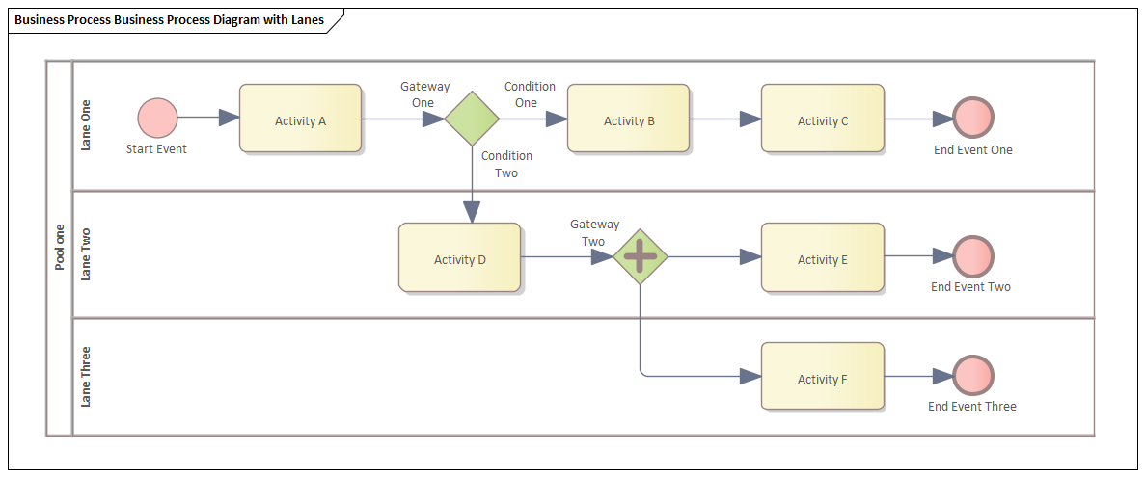
Problem Statement
Challenge: How to compute coverage for any executable model?
Dependency of existing coverage computation approaches to specific xDSLs
E.g., State coverage in the context of state machines
Recurrent engineering of new xDSLs
For every new xDSL, a new coverage tool must be provided
Arduino Activity Diagram State Machine Business-Process
Objective: A generic coverage computation approach for xDSLs

Slide 9
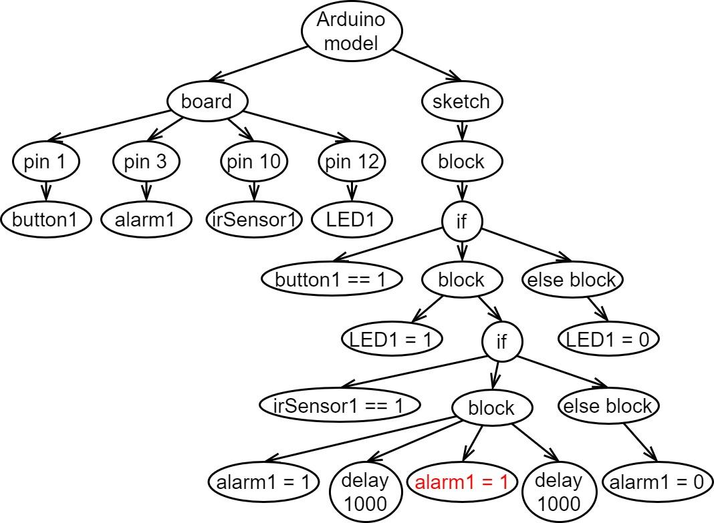
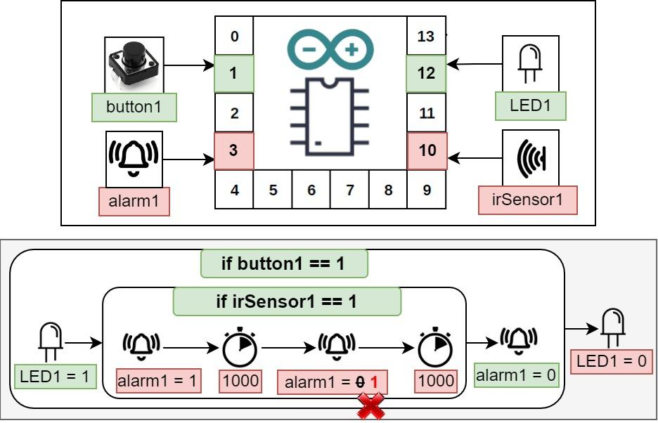
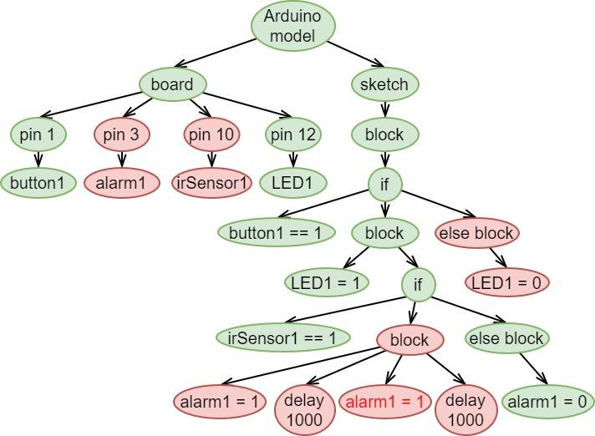
models as graphs (nodes = model elements)
node coverage as model element coverage

Slide 10
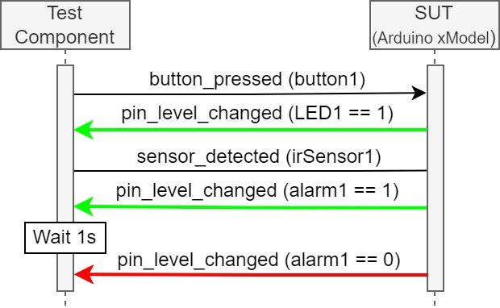
Model-under test
Test case
What about not-traced elements?
Does not-traced mean not-covered?
<<refers to>>
<<calls>>
Execution trace
press (button1) >> execute (sketch)
>> execute (if) >> execute (LED1=1)
>> changeLevel (LED1 (level=1))
>> detect (irSensor1) >> execute (if)
>> execute (alarm1=1)
>> changeLevel (alarm1 (level=1))
>> execute (delay (value=1000))
>> execute (alarm1 =1)
>> execute (delay (value=1000))
xArduino DSL Execution Rules
press (PushButton)
detect (InfraRedSensor)
changeLevel (DigitalPin)
execute (If)
execute (Sketch)
execute (ModuleAssignment)
execute (Delay)
<<generates>>

Slide 11
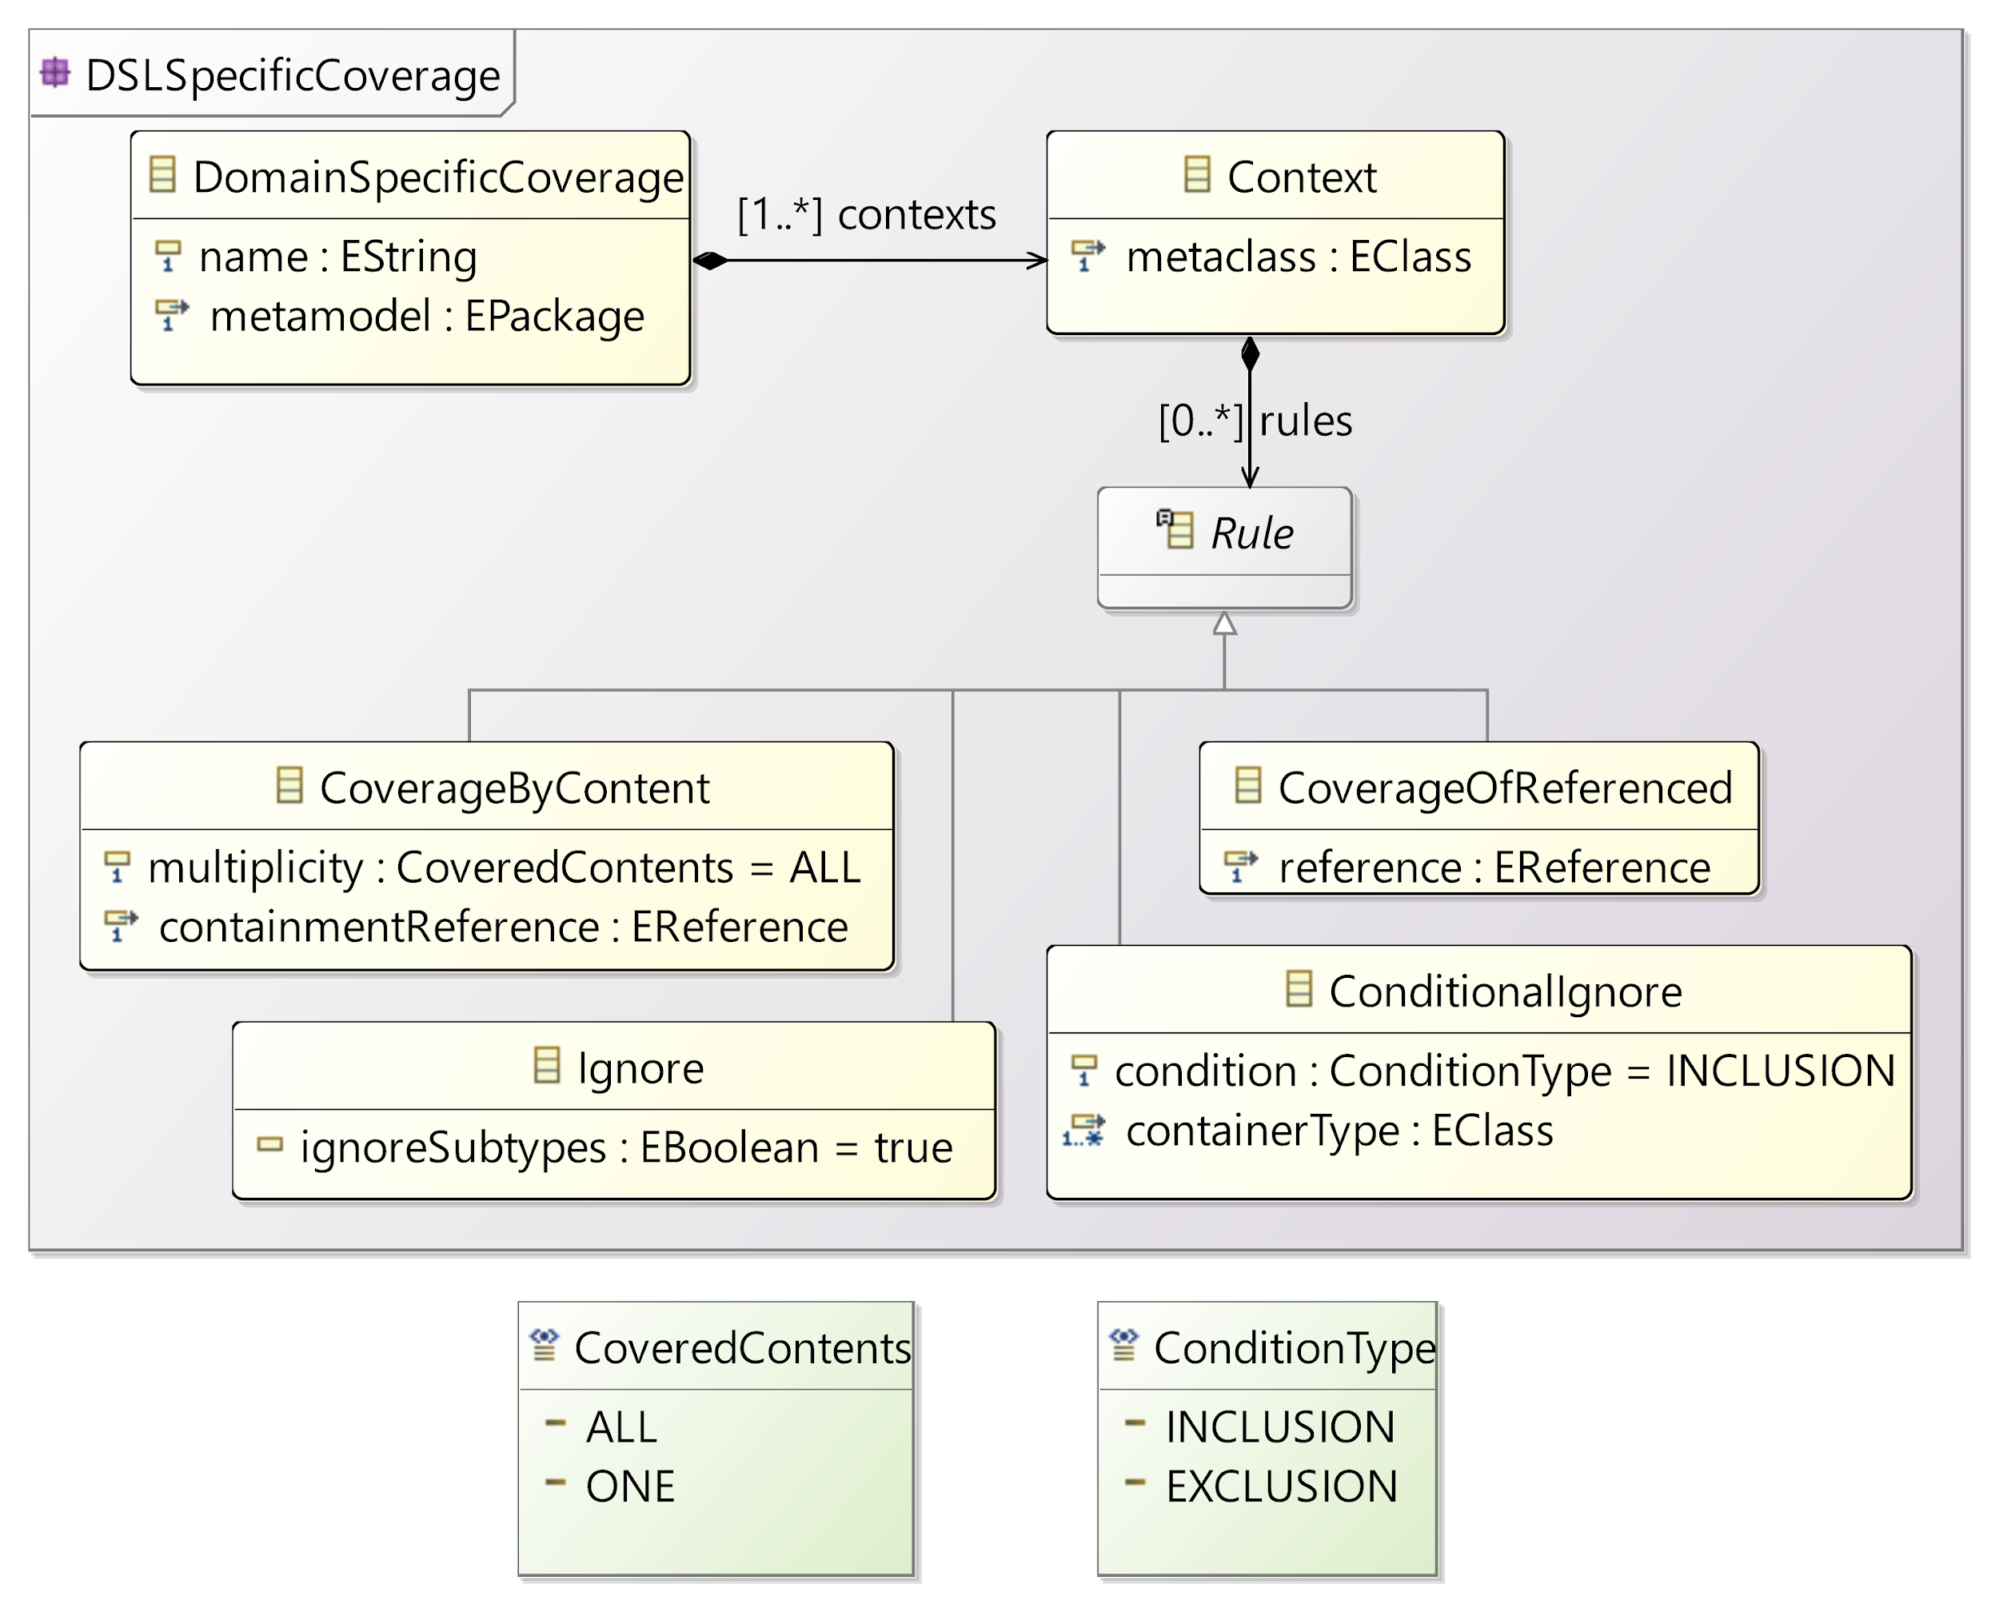
DSL-Specific Coverage Rules
Inclusion rules: a covered object may induce the coverage of other objects
Exclusion rules: an object is ignored in the coverage computation under a certain condition

Slide 12
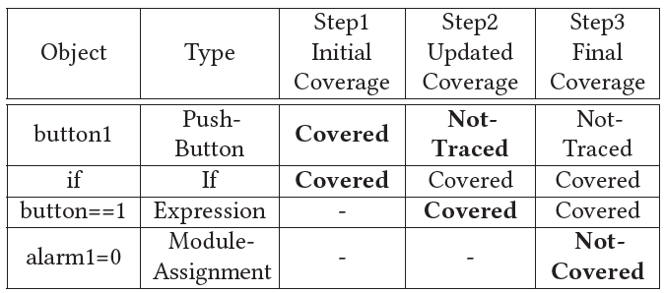
Example: Arduino-Specific Coverage Rules
Based on execution trace

Slide 13
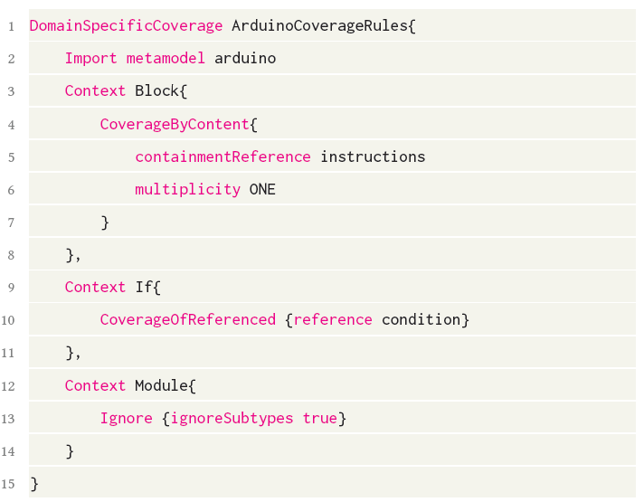
Example: Arduino-Specific Coverage Rules
Based on execution trace
Based on coverage rules

Slide 14
Example: Arduino-Specific Coverage Rules
Based on execution trace
Based on coverage rules
Final coverage matrix

Slide 15

Approach Overview
Executable DSL (xDSL)
Tests for an xModel
conforms to
defines
Domain
Expert
defines
Abstract Syntax
Executable Model
under test
specific to
Test Cases
Language
Engineer
imports
Operational Semantics
refers to
run tests on xModels
refers to
runs
uses
Test
Execution Engine
Implemented by
Behavioral Interface
uses
Execution Traces
Test Results
imports
reads
DSL-Specific Coverage Rules (optional)
xModel Coverage
Computation
Coverage
Legend
depends on
Manually- defined artefact
Generated artefact
Existing
Tool
Proposed Tool
produces
user action

Slide 16
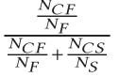
Fault localization of executable models
Spectrum-Based Fault Localization (SBFL)
Input: Test execution result + test coverage
Output: Suspiciousness-based ranking of the software components
Model elements (EObjects)
Tarantula =
NCF: number of failed test cases that cover the element
NCS: number of successful test cases that cover the element
NS: total number of successful test cases
NF: total number of failed test cases
SBFL for xDSLs:
test execution result + test coverage =>
suspiciousness-based ranking of the models elements
[3] Troya, J., Segura, S., Parejo, J.A. and Ruiz-Cortés, A., Spectrum-based fault localization in model transformations. ACM Transactions on Software Engineering and Methodology (TOSEM), 27(3), pp.1-50, 2018.

Slide 17
Approach Overview
Executable DSL (xDSL)
Tests for an xModel
conforms to
specific to
defines
Domain
Expert
defines
Abstract Syntax
Executable Model
under test
Test Cases
Language
Engineer
imports
Operational Semantics
refers to
run tests on xModels
refers to
runs
uses
uses
Test
Execution Engine
Implemented by
Behavioral Interface
Visualization
uses
uses
Execution Traces
Test Results
Test Result UI
imports
reads
Test Coverage UI
DSL-Specific Coverage Rules (optional)
uses
xModel Coverage
Computation
Fault Localization UI
Coverage
reads
reads
uses
xModel Fault
Localization
Suspiciousness ranking
Legend
depends on
Manually- defined artefact
Generated artefact
Existing
Tool
Proposed Tool
produces
user action

Slide 18
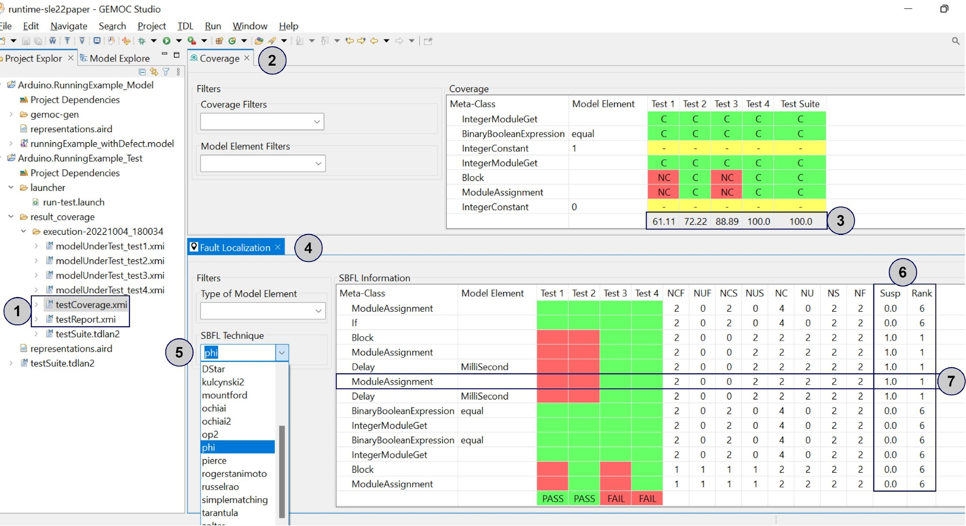
Tool Support

Slide 19
Evaluation
RQ1: How much genericity is supported by the framework and how much customization is needed to have the intended coverage computations for xDSLs?
xDSL | xFSM | xArduino | xPSSM | xMiniJava | Total
Abstract syntax size (#of EClasses) | 3 | 59 | 39 | 76 | -
#of tested models | 5 | 6 | 4 | 6 | 21
#of test cases | 45 | 22 | 153 | 77 | 297
#of DSL-specific coverage rules | - | 8 | 13 | 4 | 25
DSL-specific coverage size (LoC) | - | 50 | 75 | 26 | 151

Slide 20
Evaluation
RQ2: To what extent is the result of the coverage computation component valid?
Comparing our coverage tool for xMiniJava DSL with CodeCover Java coverage tool
xMiniJava Test Cases | Our Coverage | CodeCover Coverage
Test 1 | 23/33 = 69.70% | 24/35 = 68.57%
Test 2 | 7/36 = 19.44% | 7/43 = 16.28%
Test 3 | 28/49 = 57.14% | 31/56 = 55.36%
Test 4 | 51/54 = 94.44% | 55/60 = 91.67%
Test 5 | 46/119 = 38.66% | 57/144 = 39.58%

Slide 21
Evaluation
RQ3: Can the generically computed coverage measurements be used in fault localization techniques?
Generating faulty models using mutation testing technique [4]
xDSL | xFSM | xArduino | xPSSM | xMiniJava | Total
#of mutation operators | 5 | 36 | 30 | 113 | 184
#of tested models | 5 | 6 | 4 | 6 | 21
#of generated faulty models | 194 | 457 | 308 | 120 | 1079
#of fault localized models | 194 | 452 | 304 | 119 | 1069
[4] Gómez-Abajo, P., Guerra, E., Lara, J.D. and Merayo, M.G., Wodel-Test: a model-based framework for language-independent mutation testing. Software and Systems Modeling, 20(3), pp.767-793, 2021.

Slide 22


From Coverage Computation to Fault Localization: A Generic Framework for Domain-Specific Languages
Faezeh Khorram¹, Erwan Bousse¹, Antonio Garmendia², Jean-Marie Mottu¹, Gerson Sunyé¹, Manuel Wimmer²
¹IMT Atlantique, Nantes Université, Nantes, France
²Johannes Kepler University (JKU), Linz, Austria
Link to the paper: https://hal.archives-ouvertes.fr/hal-03815772v1
Link to the tool: https://github.com/Faezeh-Kh/Coverage4DSLs

